Slide 2
Notes:
An Our Health Services Rainbow helps children understand this continuum of care, from self-care to emergency care, visually represented through the rainbow colours.
The different colours of the rainbow represent different health services.
People who provide health services are known as health professionals e.g. doctor, pharmacist, nurse, paramedic
Sometimes you need help from a health professional, such as a pharmacist, when you are unwell and other times you get better through self-care at home if you have a common illnesses such as a cold.
Pharmacists are experts in managing common illnesses and are trained to know when something might be more serious. You can also ask your pharmacist for advice.
The green on the rainbow represents the pharmacy, which is the focus of this presentation.

Slide 3
Notes:
These are five examples of some common childhood illnesses in Northern Ireland.
Can the children recognise the different illnesses?

Slide 4
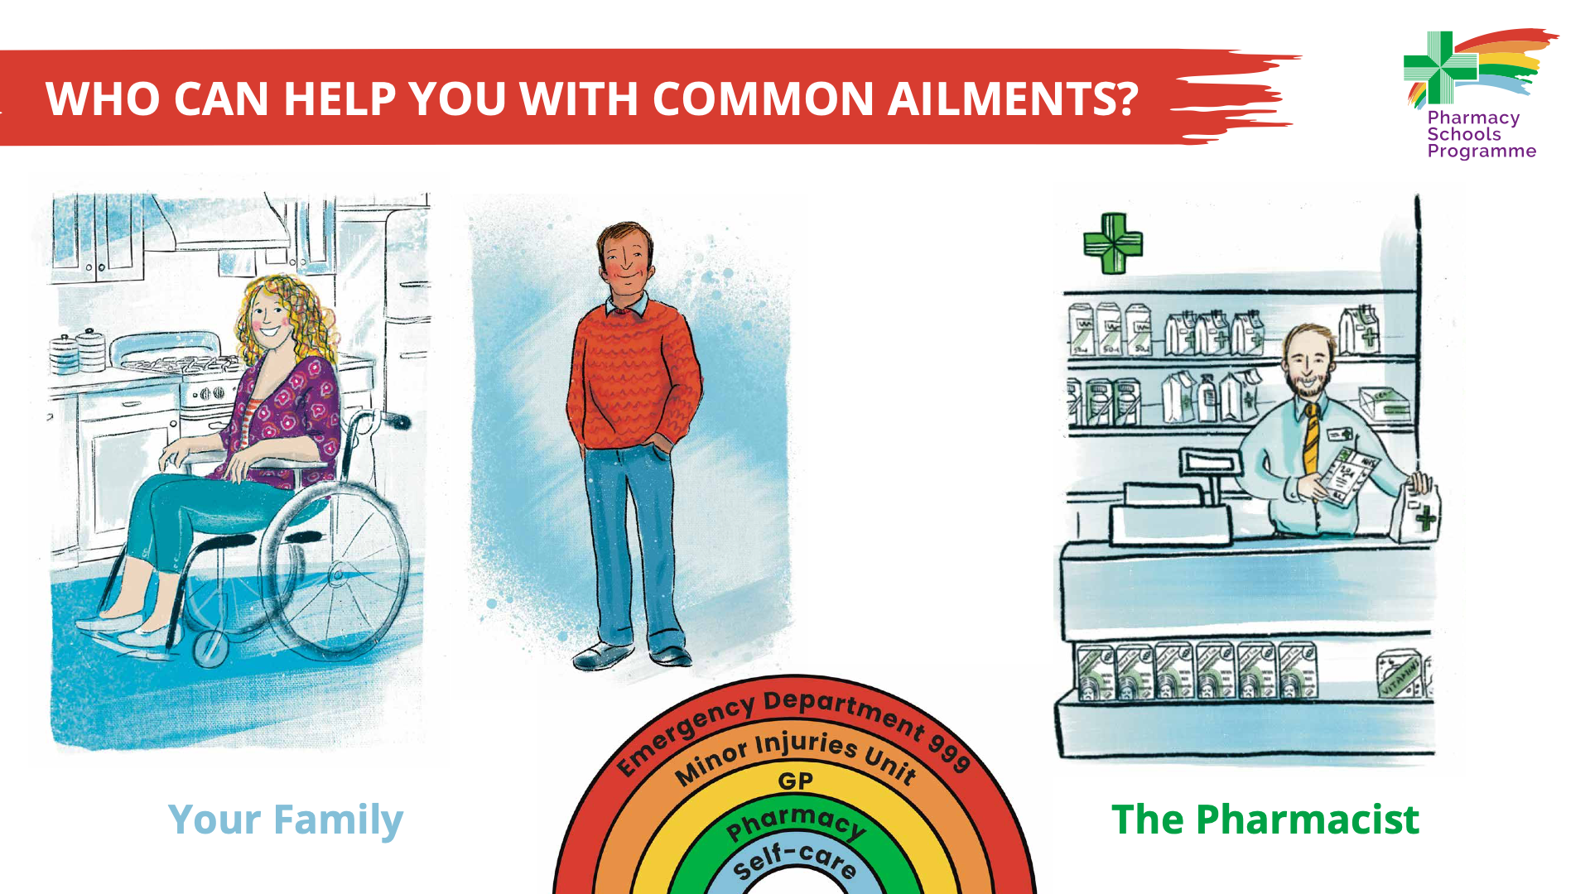
Notes:
The treatment of common illnesses, such as sore throat, is often by self-care (blue on Our Health Services Rainbow) or with the help of the pharmacist (green on Our Health Services Rainbow). Pharmacists are trained to help treat common illnesses or can advise you to see a GP (yellow on the Our Health Services Rainbow). If you are not sure whether you can manage your illness by self-care, please seek advice from the pharmacist.
Blue on the Our Health Services Rainbow (self-care) is your family (parents/guardians/carers and significant others).
Green on the Our Health Services Rainbow is your pharmacist.

Slide 5
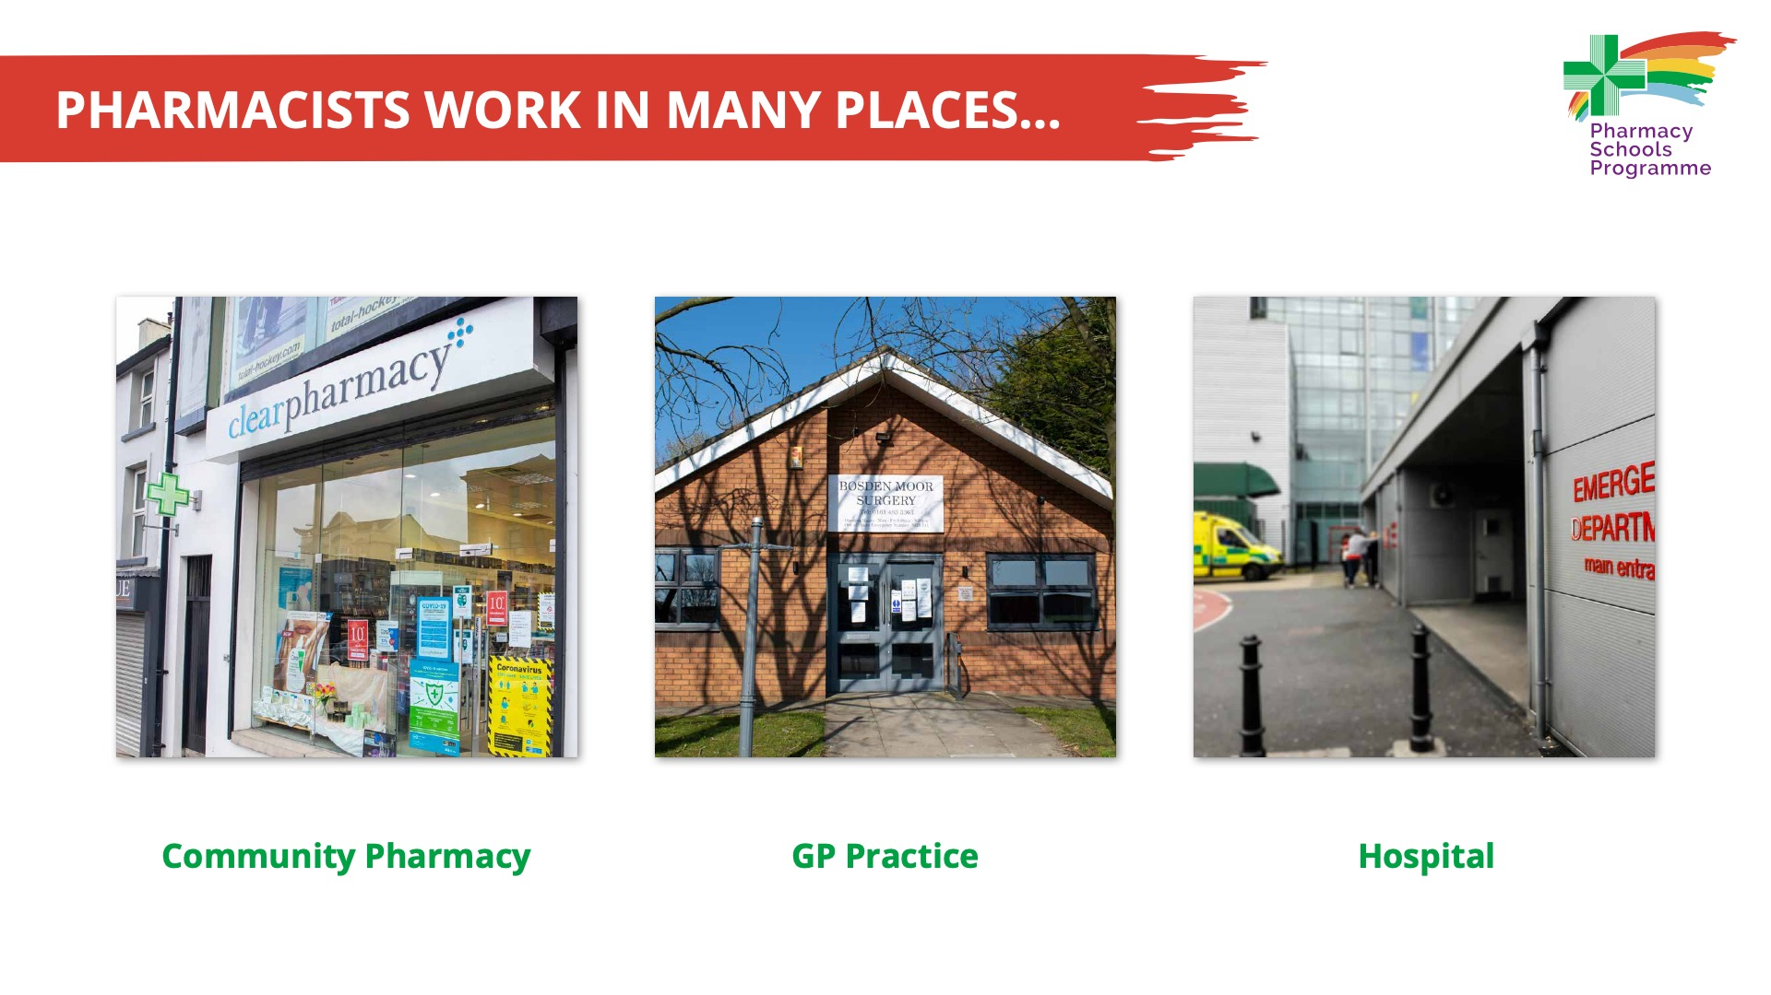
Notes:
Pharmacists work in many places. This slide shows the most common places children may have met a pharmacist:
Community pharmacy
GP Practice
a hospital.
Pharmacists in Northern Ireland also work in an industry setting; researching, designing, developing and testing new medicines and at Universities: Queen’s University Belfast and Ulster University.

Slide 6
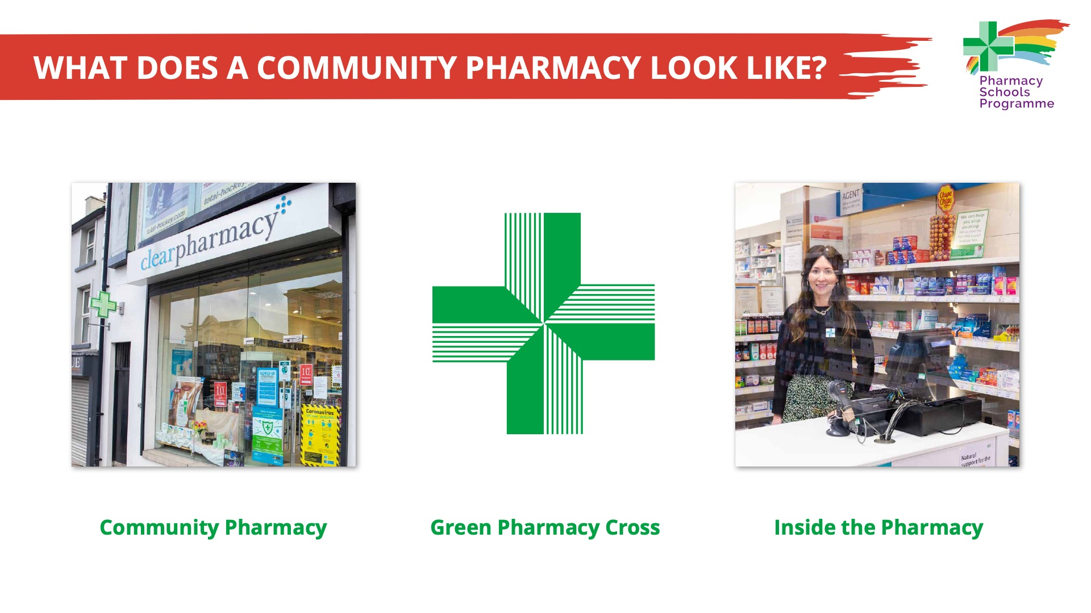
Notes:
1. Community pharmacies can be found in villages, towns and cities, for example, independent pharmacies or multiples e.g. Boots, Gordons, Medicare. They can be found in shopping centres as well as on the street, just like a lot of other shops.
2. An easy way to recognise a pharmacy is to look out for the green cross pharmacy logo outside the shop.
3. A pharmacy will have a consultation room for people to speak to the pharmacist in private or receive an injection / vaccine.

Slide 7
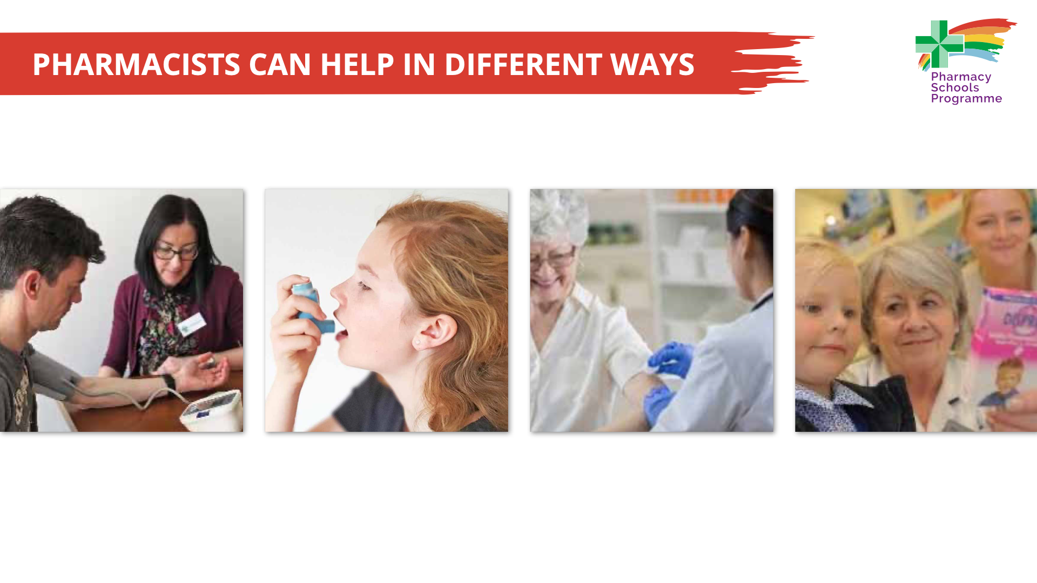
Notes:
Pharmacists can help you to stay healthy in many different ways. Ask the children if they have asked the pharmacist for any help in the past?
Pharmacists can help by:
Giving advice
Measuring your blood pressure
Checking your asthma inhaler technique
Delivering flu vaccinations
Supplying medicines that are safe and right for you and help you take these correctly
Helping you to keep your mind and body healthy.

Slide 8
Notes:
Medicines come in different shapes and sizes.
Explore with the children what shapes the medicines look like, such as squares, ovals, rectangles etc.
Explain to the children that medicines are taken via different parts of the body, for example, directly into the eyes, ears, nose, swallowed, inhaled, applied to your skin and injected.
The pharmacist can help you to make sure that you are using your medicine in the correct way.
The illustrations show that medicines can come in different forms, such as topical (cream/ointment/gel/lotion), eye drops, ear drops, nose drops/spray, oral – tablets/capsules, liquids, injections and inhalers.

Slide 9
Notes:
The aim of the slide is to help children understand there are different ways you can get medicines.
We can get ‘prescription’ medicine free of charge from a pharmacist. The pharmacist will make sure the medicine on the prescription is the right medicine for you.
Parents/guardians/carers and significant others can buy ‘over-the counter’ medicines from pharmacies, supermarkets or local shops that may help you get better.

Slide 10
Notes:
This slide emphasises one way to make sure you take your medicine safely, is by using the correct dosage measurement when taking a liquid medicine, like paracetamol.
Ask the children do they recognise any of the dosage measurements? Explain that you should use a medicine spoon as it will give the correct amount of medicine.

Slide 11

Notes:
Know-Check-Ask is part of the ‘Medication Without Harm’ campaign that highlights that everyone has a role to play in medication safety. The message is simple: before you prescribe, dispense or take medicine make sure you know about it.
The three simple steps children, along with their parent/guardian/carer or significant other, can take are:
Know your medication
Check that you are using the right medication in the right way
Ask a healthcare professional, such as your doctor, nurse or pharmacist, if you are not sure.
The message is that lots of people will require medication at some point in their lives, and by taking these steps it will ensure they take their medicines safely.
Though part of the video is directed at health professionals, the simple message of ‘Know-Check-Ask’ will start to help children understand their role in using their medication safely.

