Slide 2
Notes:
This PowerPoint will give children an overview of how pharmacies can help you when you are sick and to help you understand how to take your medicines safely.

Slide 3
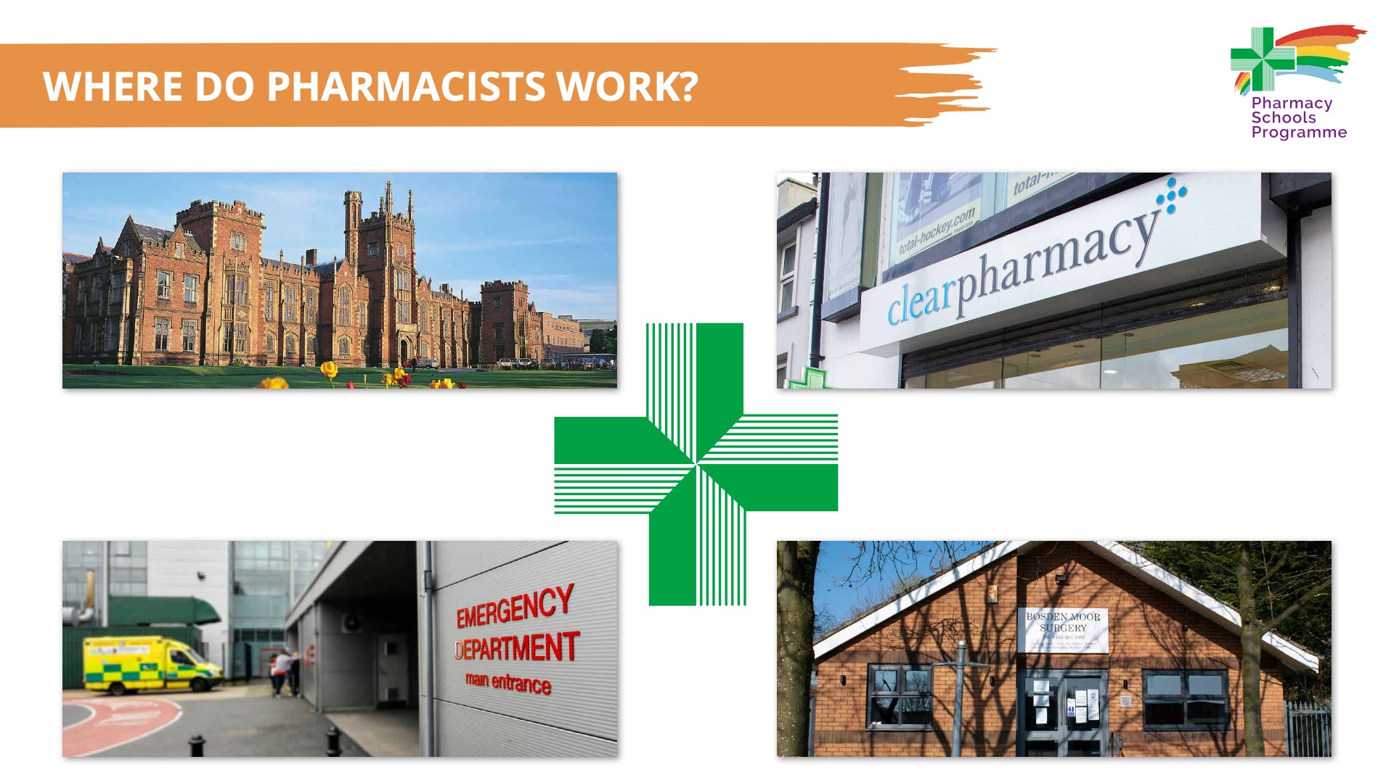
Notes:
Pharmacists can work in different places. Pharmacists can work in a community pharmacy, a GP Practice, a hospital, a University or for a pharmaceutical company (a company that makes medicines).
Pharmacists work in many places. Ask the children where they might have met a pharmacist?
Pharmacists in Northern Ireland work in:
Community pharmacies
GP Practices
Hospitals
Industry setting (researching, designing, developing and testing new medicines)
Universities: Queen’s University Belfast and Ulster University.

Slide 4

Notes:
Ask the children what services their local community pharmacy offers? The images give them some clues.
Community pharmacies offer a range of services:
Offer help and advice on keeping healthy and how to deal with common illnesses, such as colds and sore throat
Supplying medicines that are safe and right for you and help you take them correctly, this can include an inhaler for asthma
Review medication people are taking for some time for to help manage asthma and diabetes
Delivering flu vaccinations
Helping you to keep your mind and body healthy.
A community pharmacist’s job is all about helping people, assessing their conditions and helping people make the best decisions about which medicines they should take.

Slide 5
Notes:
Ask the children if they have had a prescription? Who gave them the prescription? How did they get the medicine?
In Northern Ireland, all National Health Service prescriptions are free for everyone.
A doctor or pharmacist, for example, can write you a prescription for a medicine. Take the prescription to the pharmacy, who will make up your prescription. Prescriptions can be written for many different forms of medicines, such as creams, lotions, drops, tablets, liquids, inhalers and injections.

Slide 6
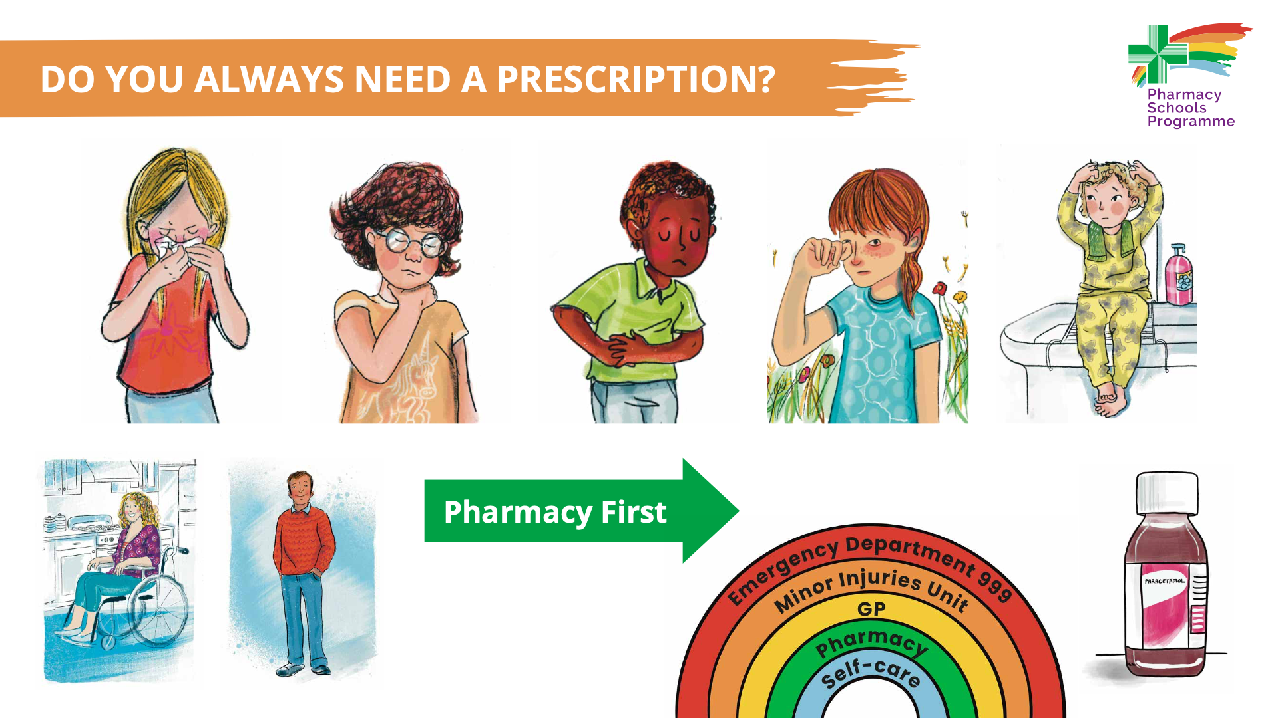
Notes:
Sometimes you do not need a prescription for an illness. Many common illnesses, such as colds, sore throats, diarrhoea, hay fever and head lice can be treated at home. You can get help and medicines without a prescription to treat these common illness from your local pharmacy. Pharmacists are trained to know when you might need to see a doctor. Sometimes, however, you do not need any medicines at all, as certain common illnesses will go away themselves after a short time.
Ask the children if they have ever had an illness that did not require any medication?
An example of a common illness which does not need treatment is a common cold, which tends to go away without the need for any medication after 7-10 days.
Likewise, hay fever is only a problem for a certain time of the year, mostly summer and so people do not need to take medicine all year round for this illness.

Slide 7
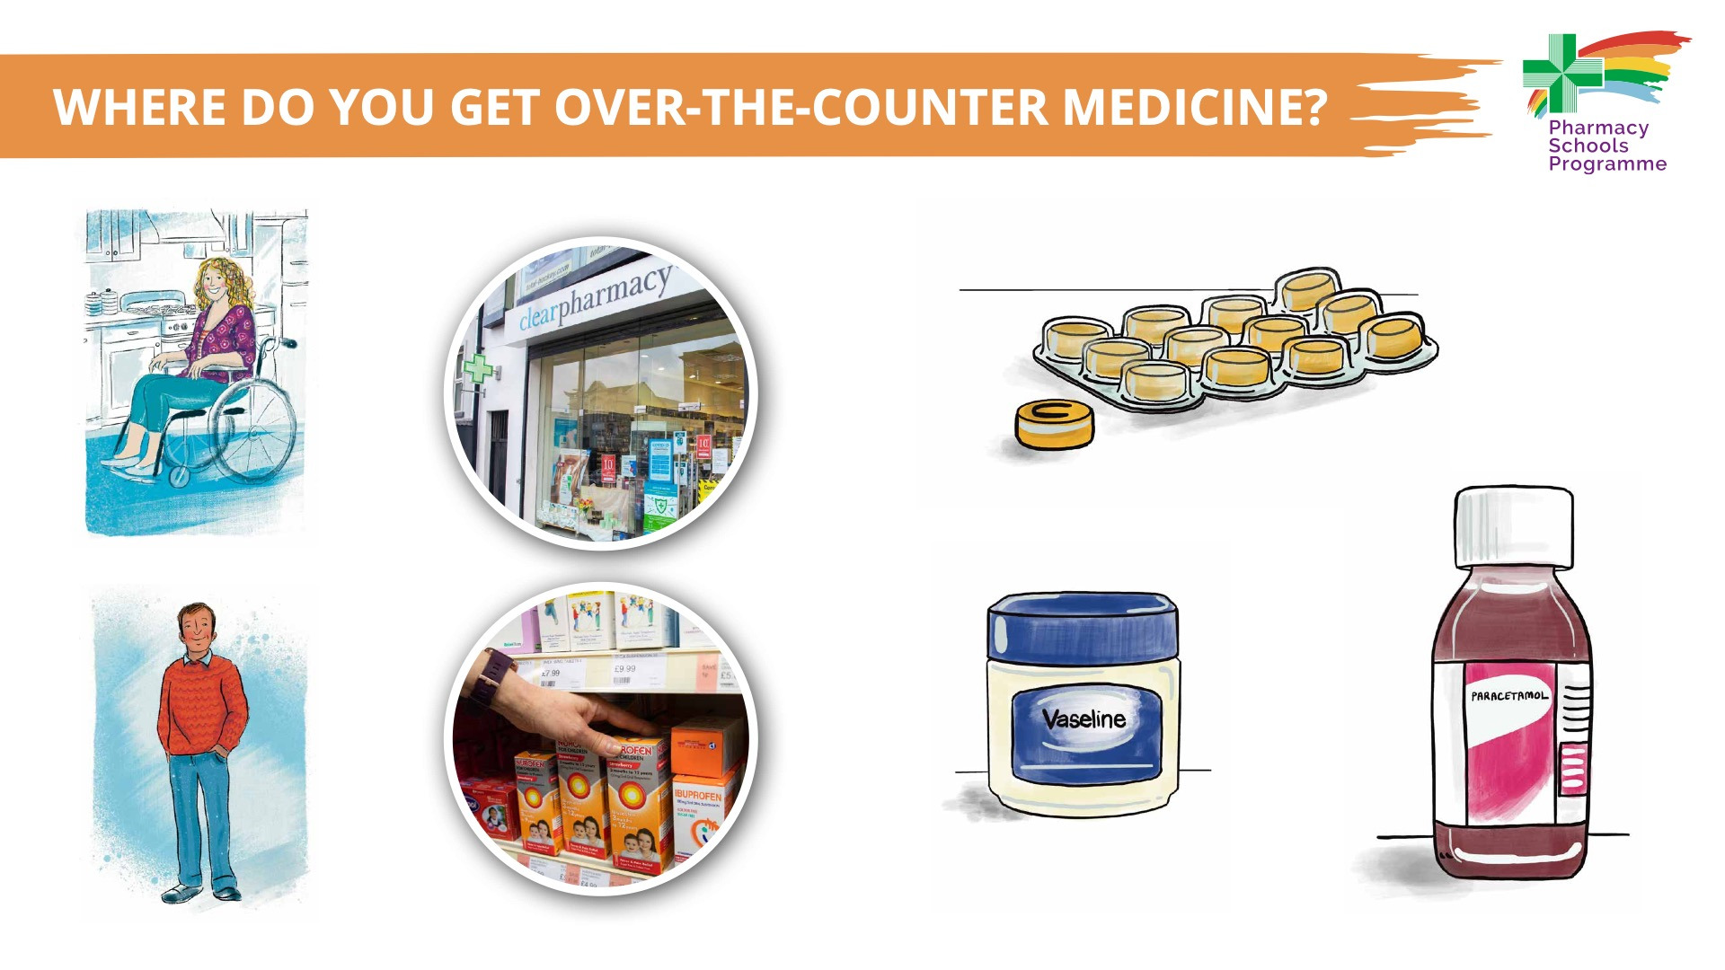
Notes:
Over-the-counter medicines are medicines that do not require a prescription. Your parent/guardian/carer or significant other can buy the medicine from either a pharmacy, a local supermarket or shop. Over-the-counter medicines can come in different forms, such as creams, drops or liquid.
Ask the children if their parent/guardian/carer or significant other has ever brought them a medicine from a pharmacy, supermarket or shop? What was the medicine?
Note:
The term over-the-counter is an informal term used to cover all general sales medicines and pharmacy medicines (see https://www.gov.uk/guidance/medicines-reclassify-your-product) and is not used in the UK medicines regulations. However, it is a term that is used to help people distinguish medicines that can be bought from those that must be prescribed.
However, it should be noted that it is not always a straightforward choice between a pharmacy and a shop/supermarket for over-the-counter medicine purchase. Not all over-the-counter medicines can legally be purchased in supermarkets or shops, for example 'Pharmacy (P) medicines' are restricted to being sold in pharmacies only.

Slide 8
Notes:
When you are given a medicine, make sure your parent/guardian/carer or significant other knows how to give you the medicine, including how often a day you should take it, and to use the correct dosage spoon, oral syringe or cup to measure the right amount. If in doubt, ask a health professional, such as the pharmacist.
Remind the children that they should always tell a health professional about any other medicines they are taking or any allergies they have, for example, when your parent/guardian/carer or significant other is buying a medicine for you in a pharmacy, they should always tell the pharmacist about any other medicines you take or allergies you have.

Slide 9

Notes:
Know-Check-Ask is part of the ‘Medication Without Harm’ campaign that highlights that everyone has a role to play in medication safety. The message is simple: before you prescribe, dispense or take medicine make sure you know about it. The three simple steps children, along with their parent/guardian/carer or significant other, can take are:
Know your medication
Check that you are using the right medication in the right way
Ask a health professional, such as your pharmacist, nurse or doctor, if you are not sure.
Lots of people will require medication at some point in their lives, and by taking these steps it will ensure they take their medication safely.
Though part of the video is directed at health professionals, the simple message of ‘Know-Check-Ask’ will start to help children understand how to take medication safely.

Slide 10
Notes:
Medicines should be kept in a safe place, out of the reach and sight of children. They also need to be kept at the correct temperature and sometimes protected from light.
This slide shows the simple steps everyone can take to ensure medicines are kept safely in the home:
Keep all medicines out of sight and reach of children
Ensure medicines are kept at the correct temperature.

